Slide 1
Design
Four types of programming tiles
Events
Orange
Event-specific arguments
Yellow
Command
Dark blue
Command-specific arguments
Light blue
Numeric values (generic)
Purple
No text
As much as possible, relate tile to feature of micro:bit, or programming concept

Slide 2
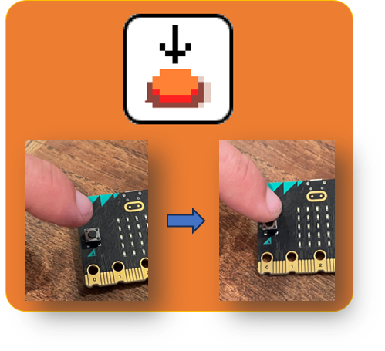
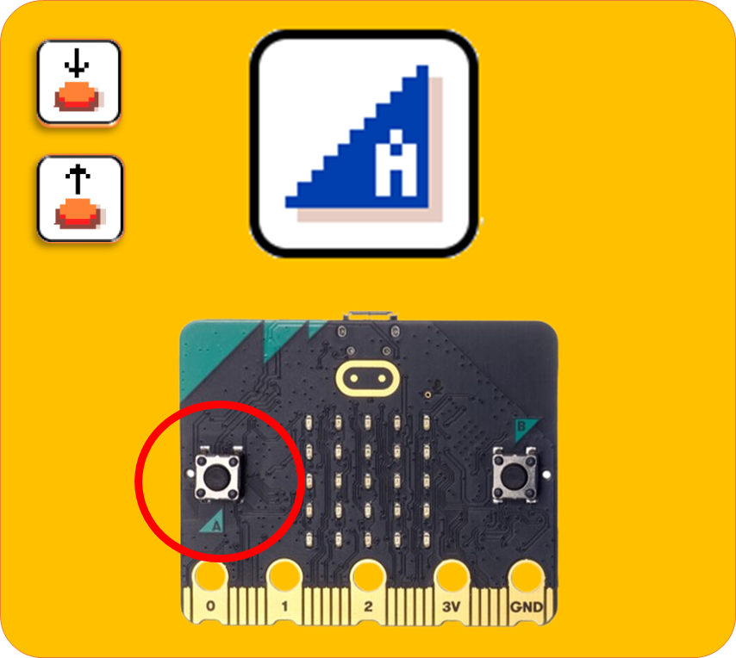
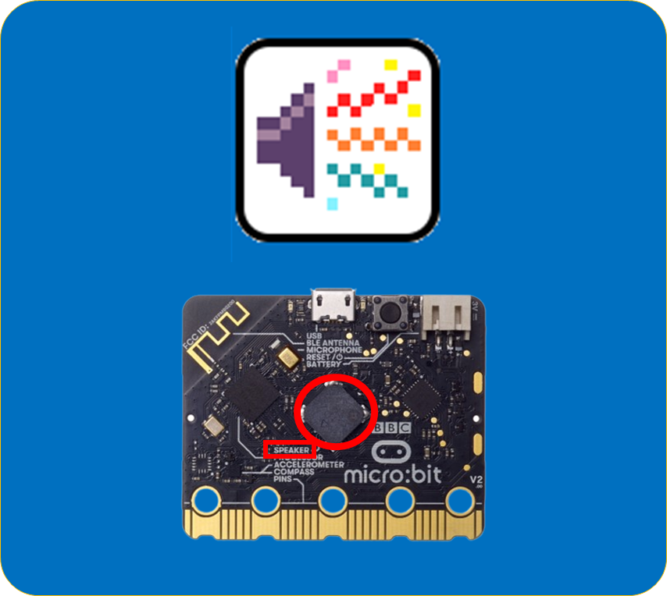
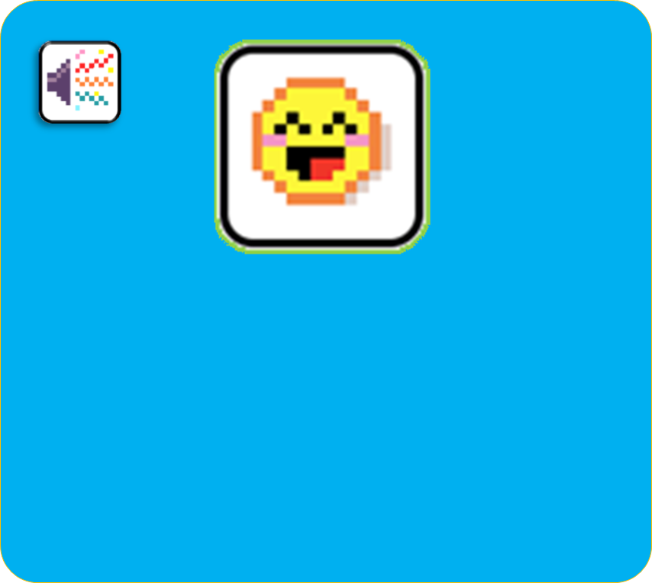

Slide 3
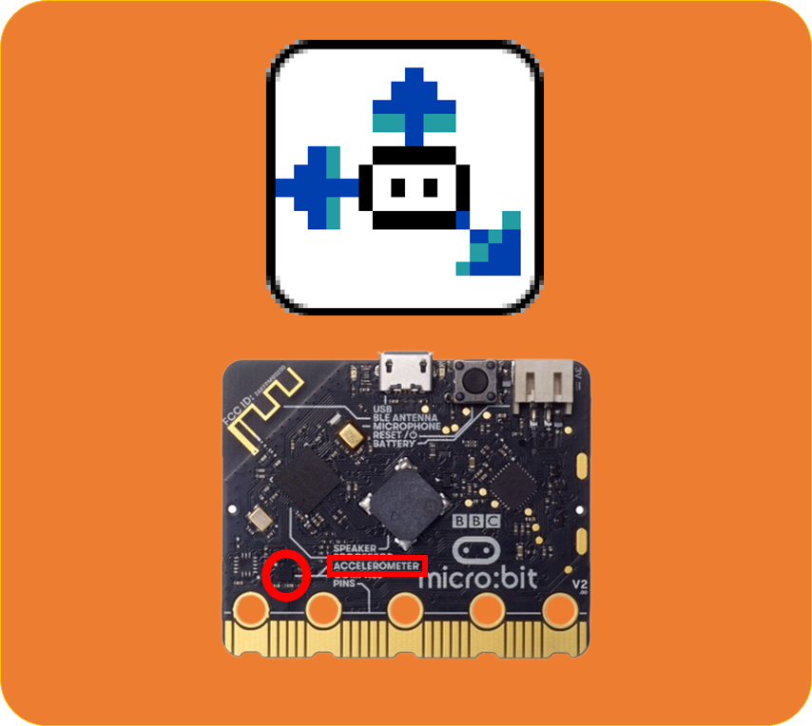
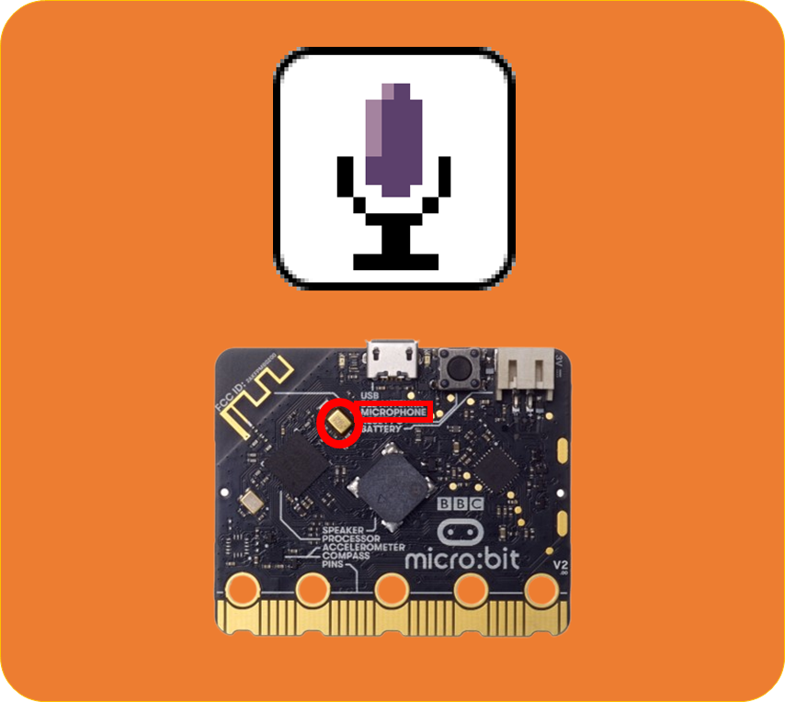
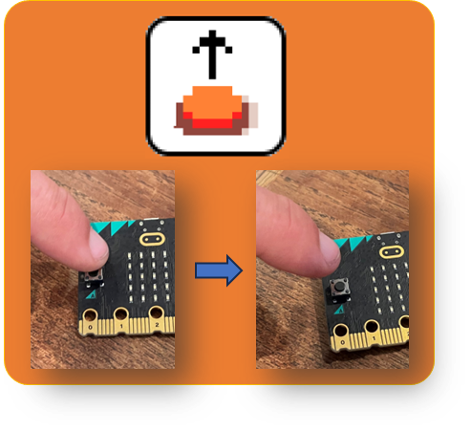
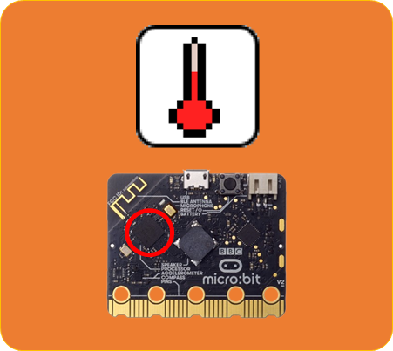
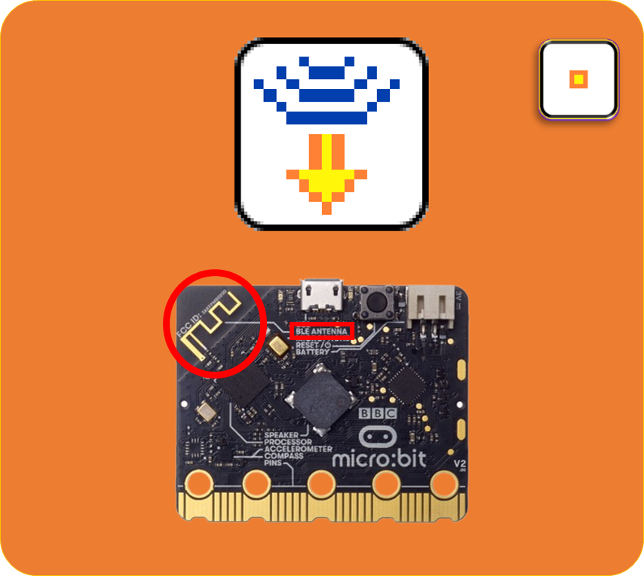

Slide 4


Slide 5
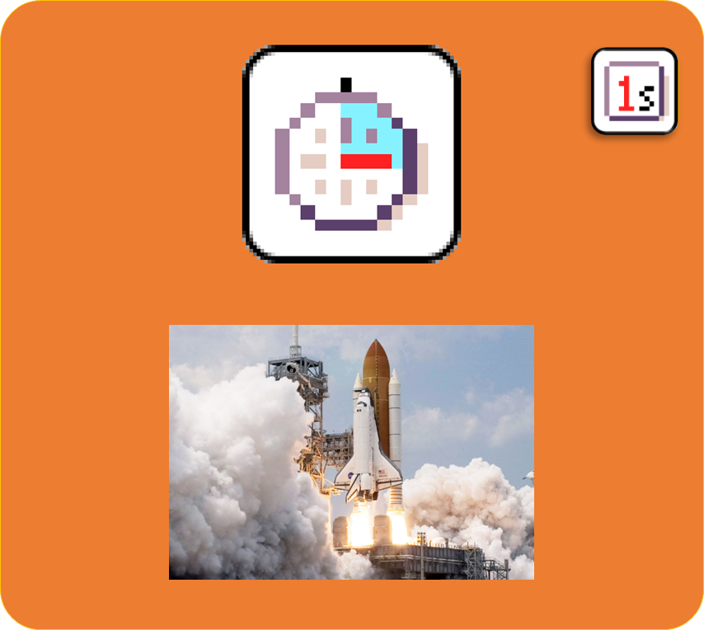
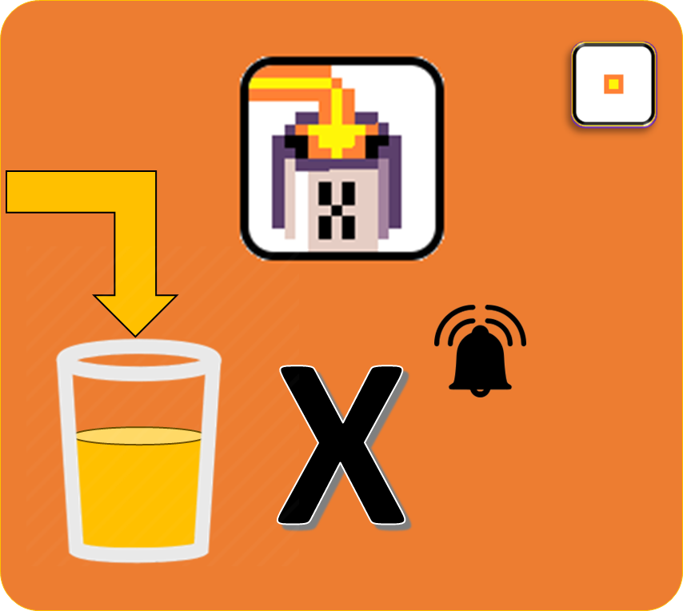
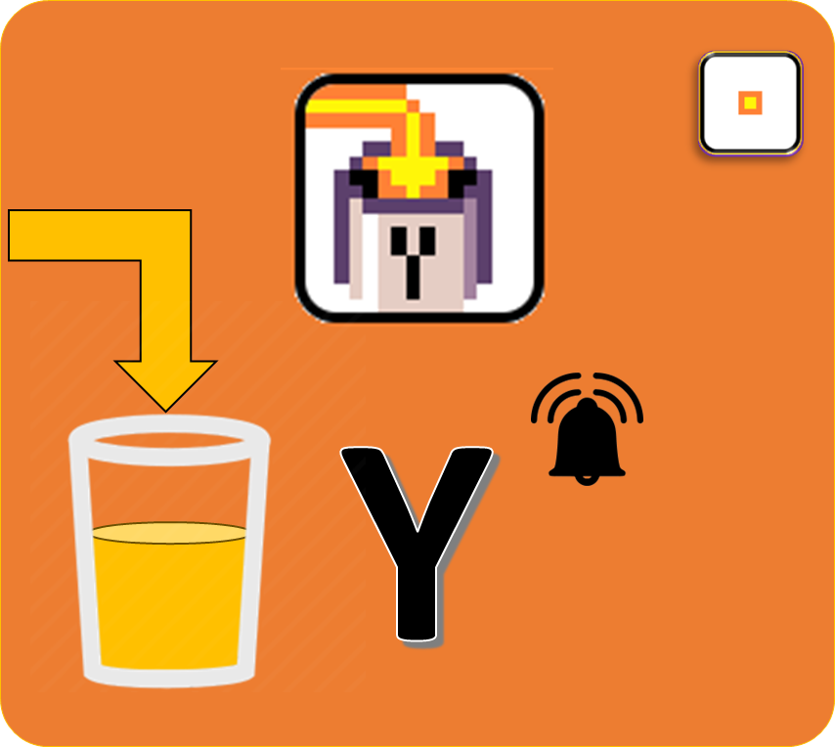
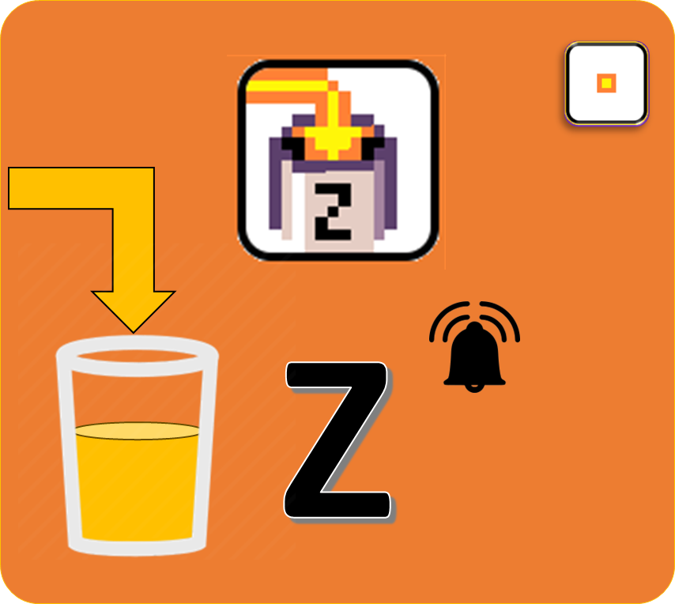



Slide 6


Slide 7
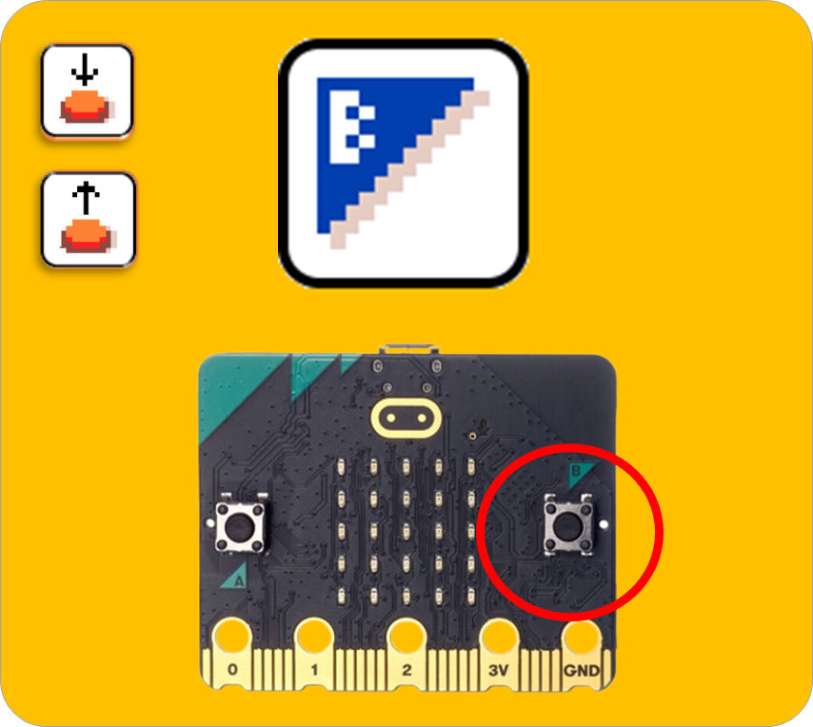
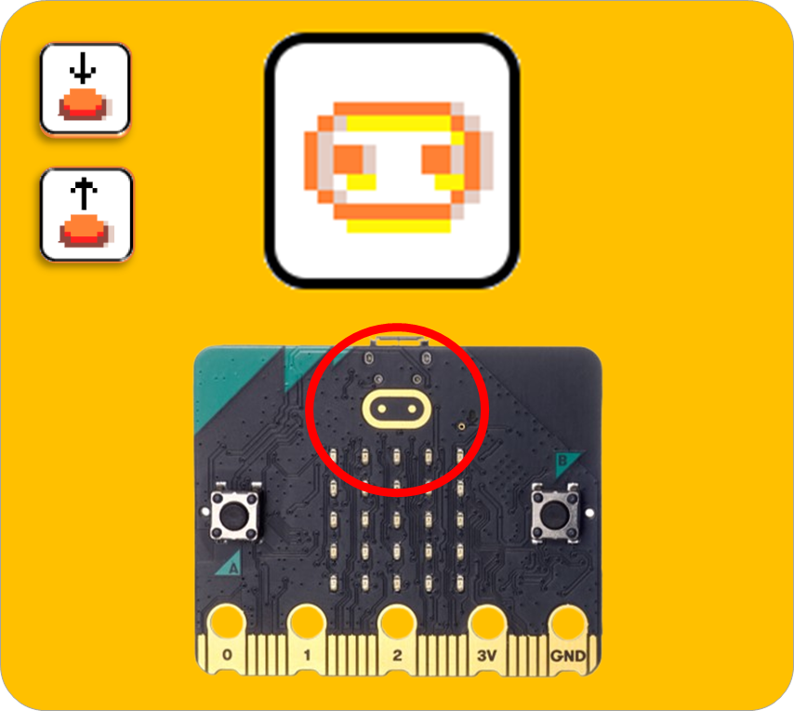
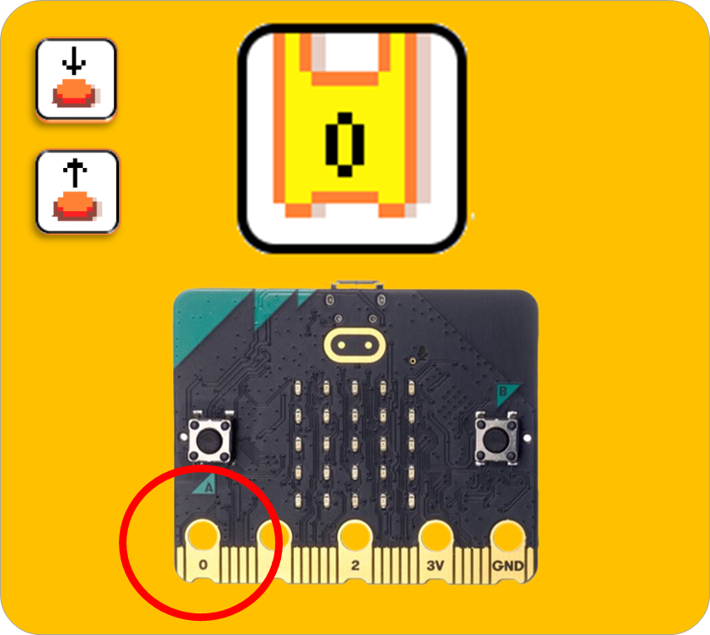
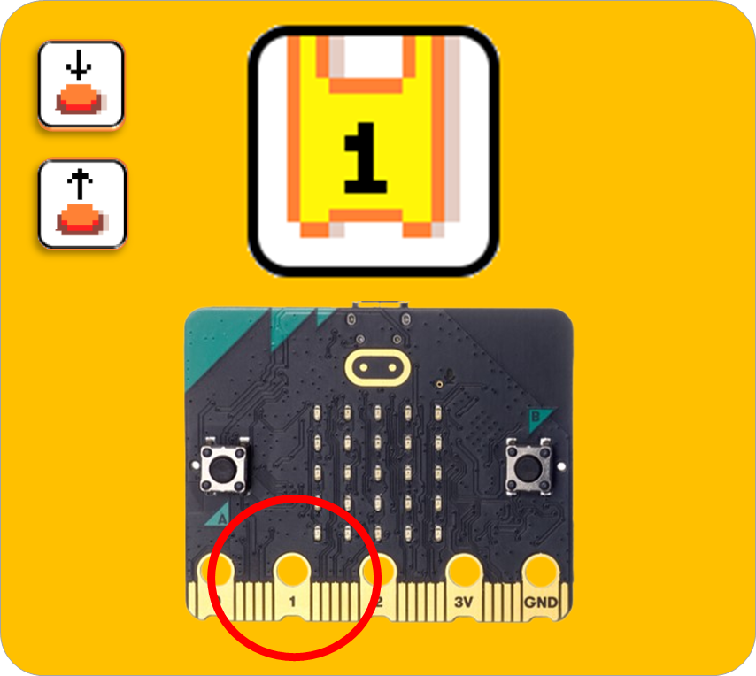
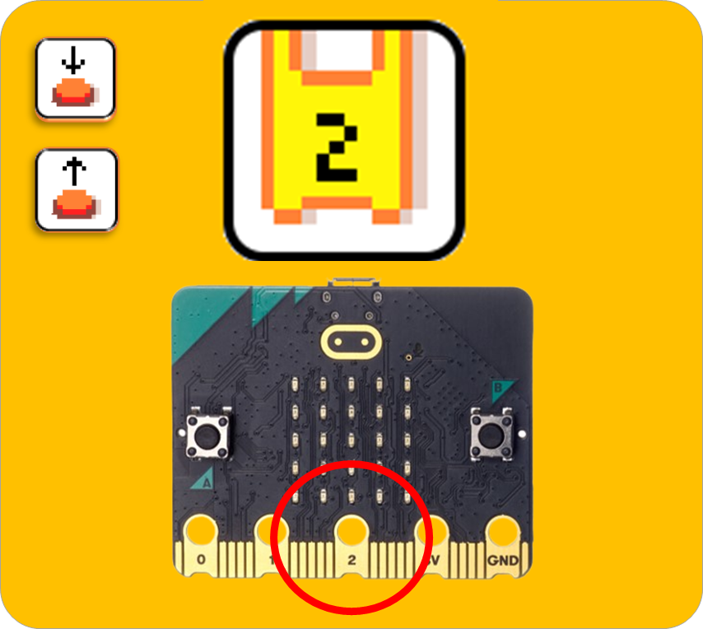

Slide 8


Slide 9
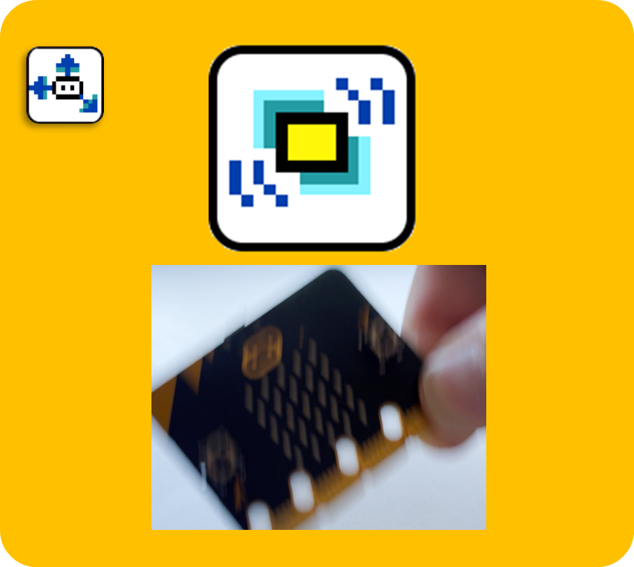
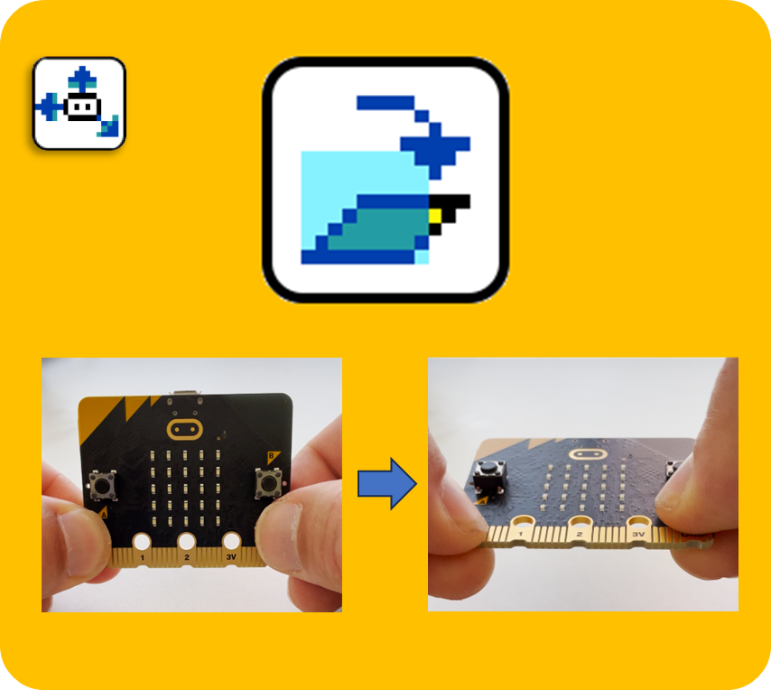
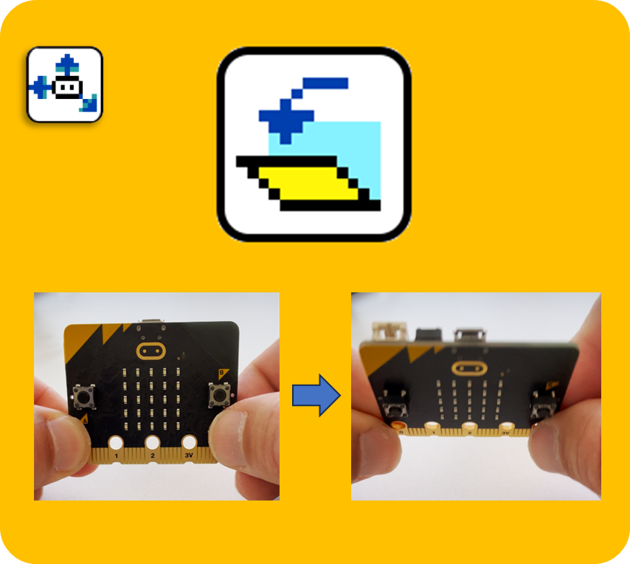
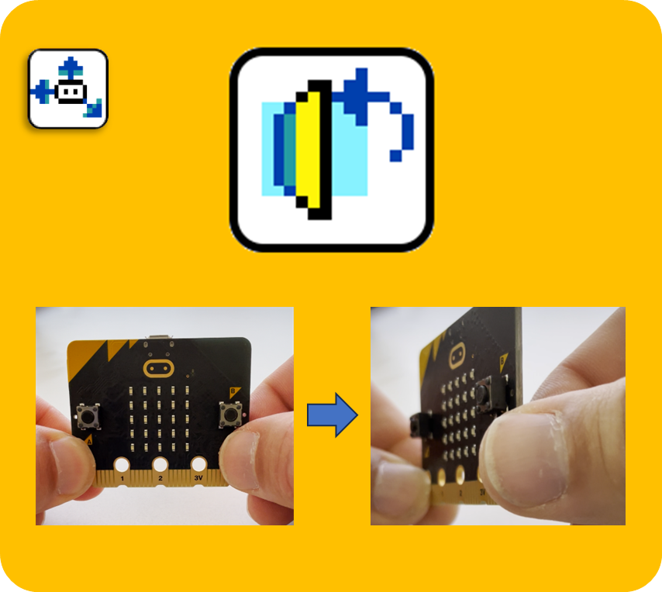
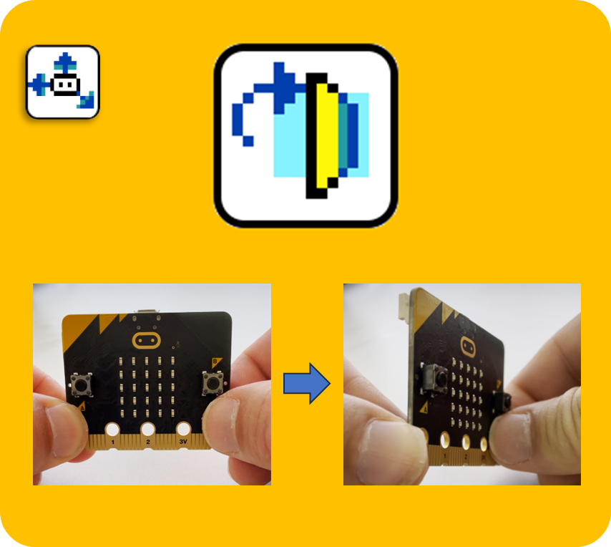
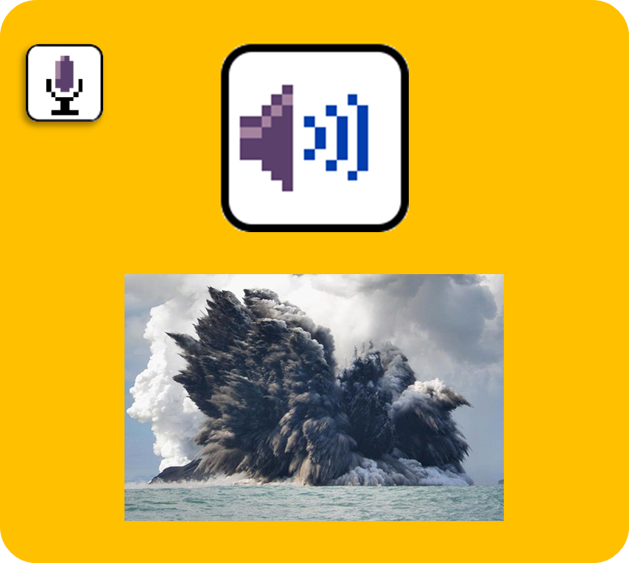

Slide 11
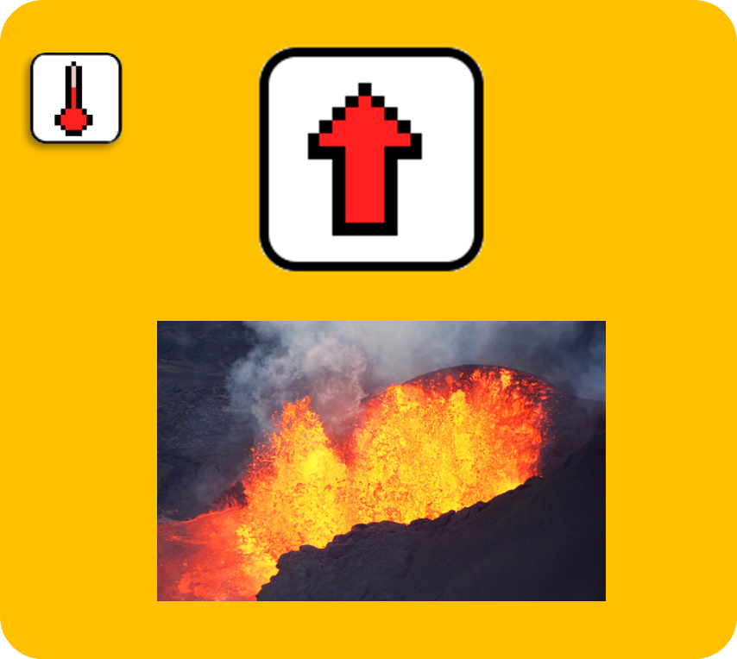
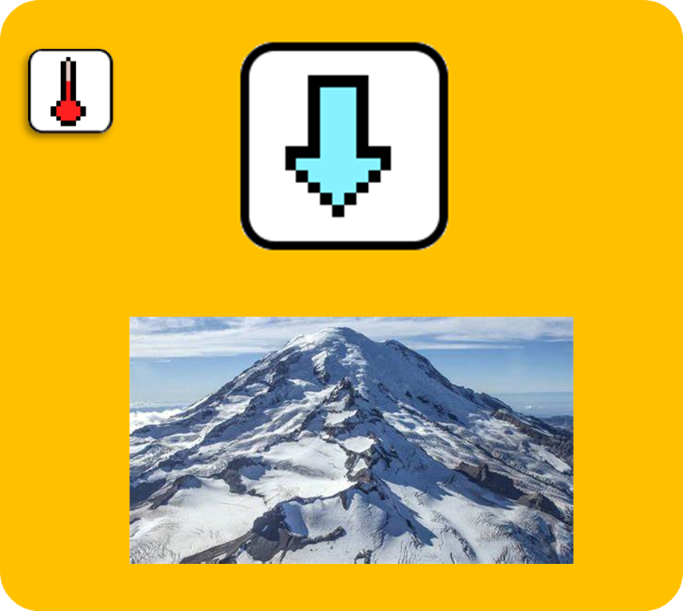
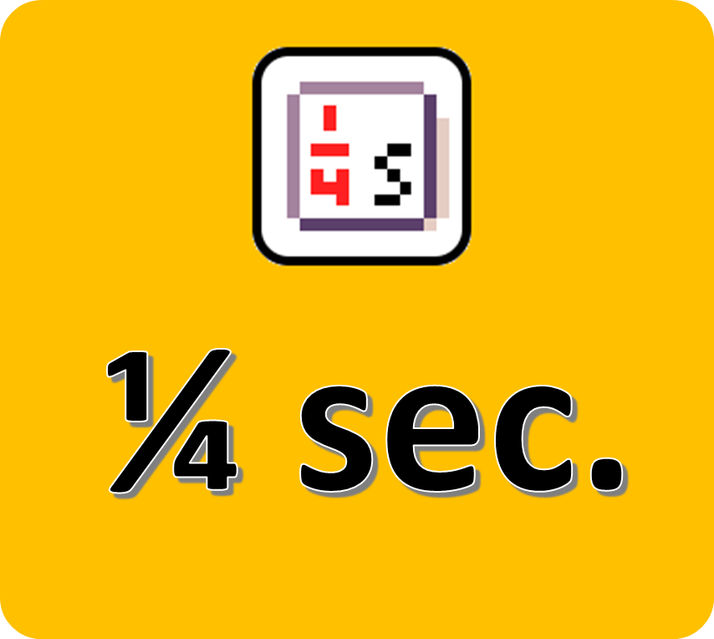
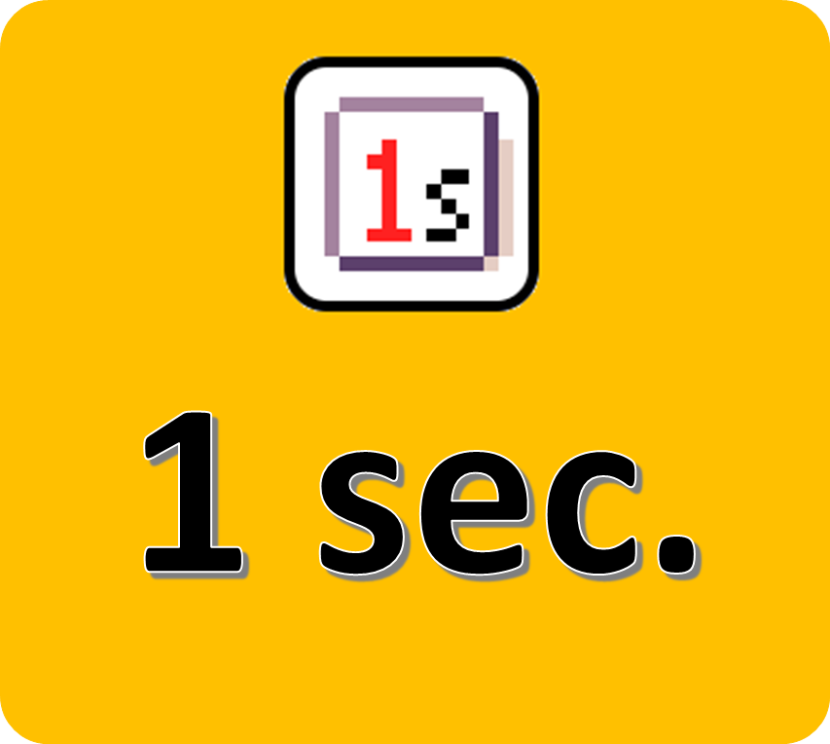
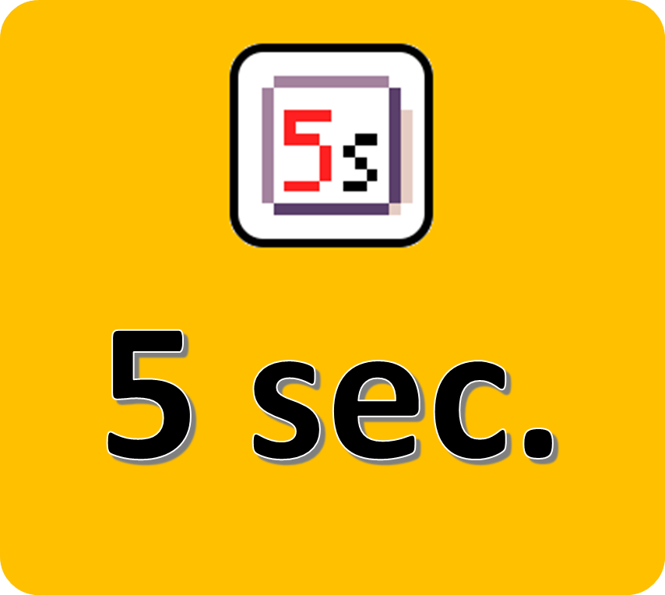
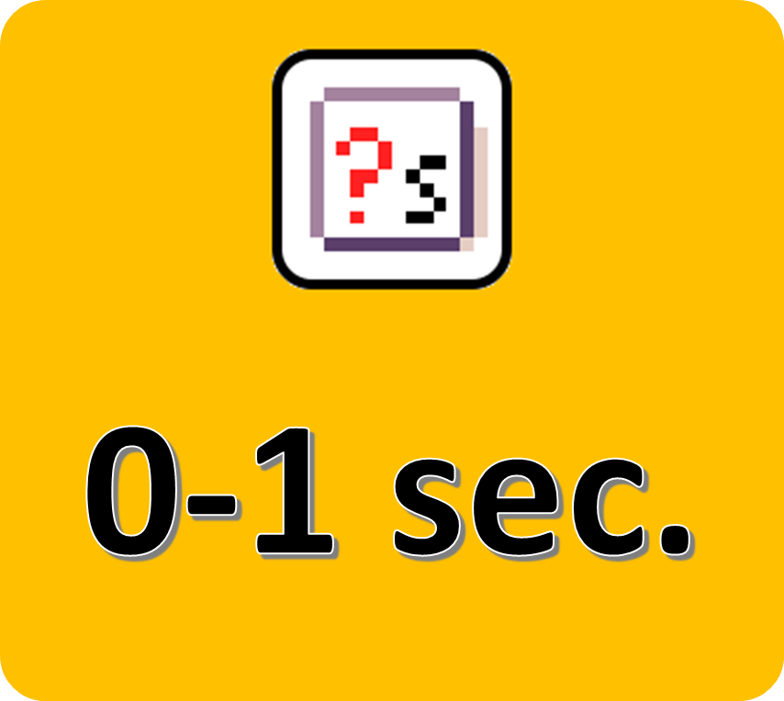

Slide 13
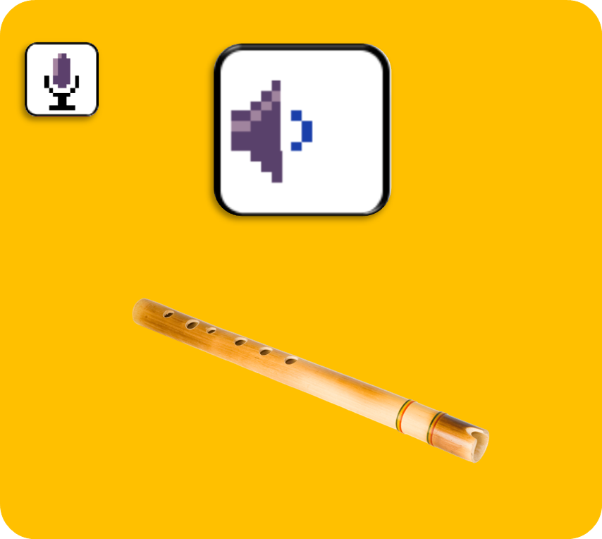

Slide 15
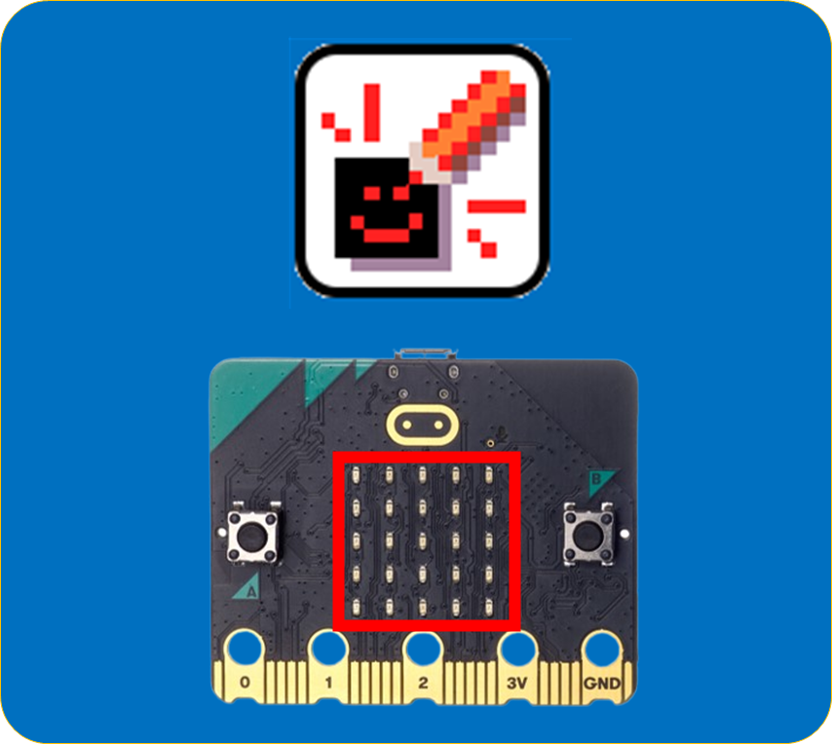
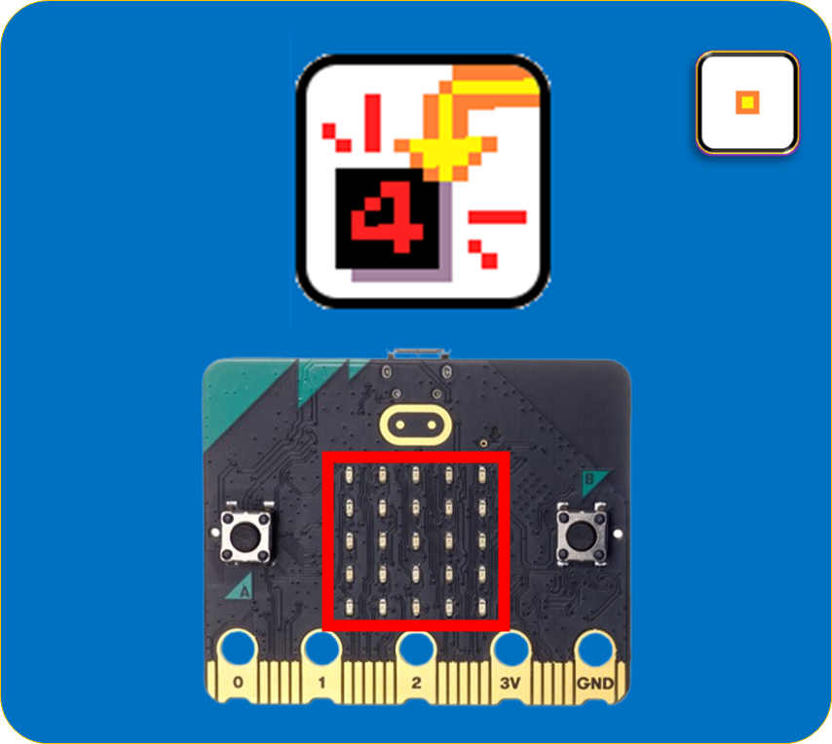
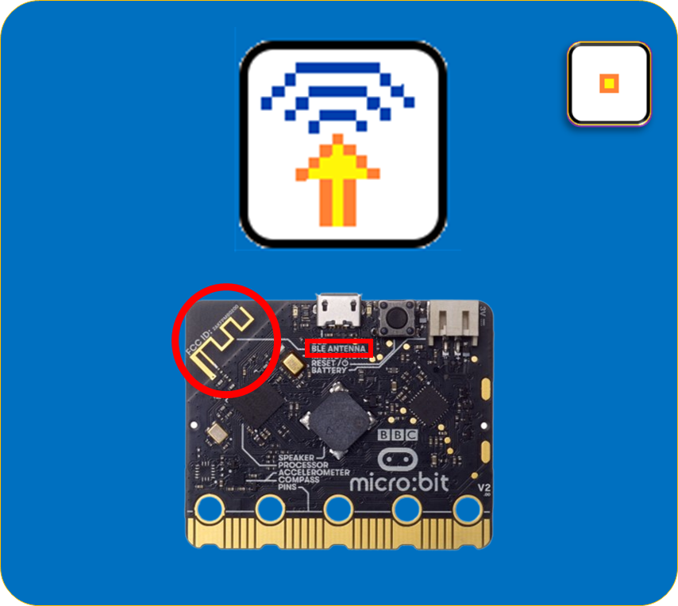
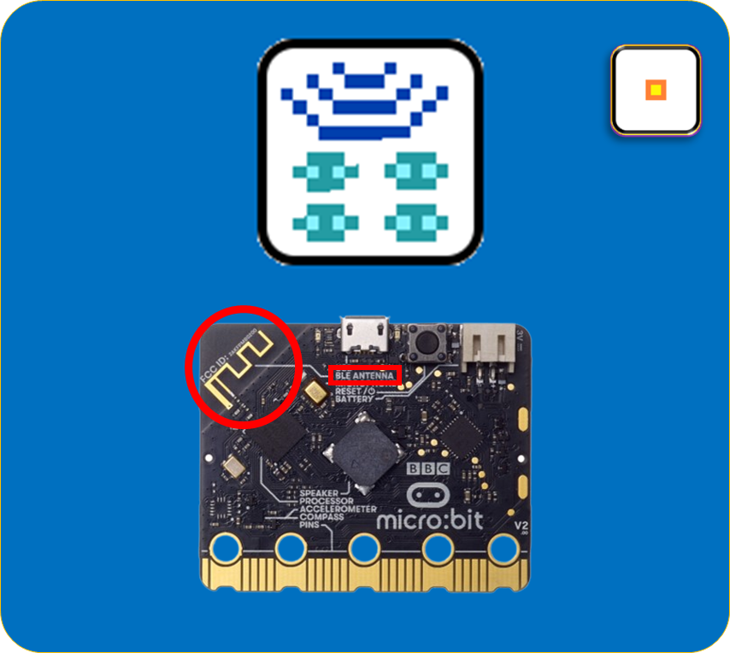
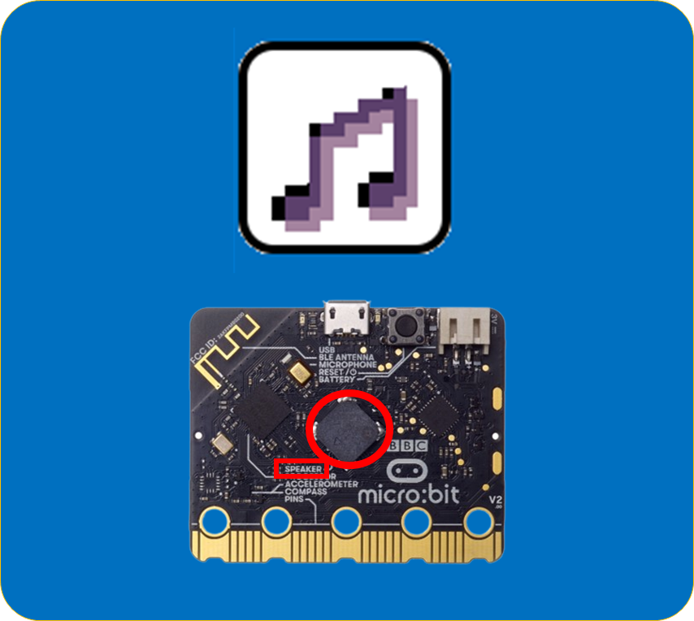

Slide 16


Slide 17
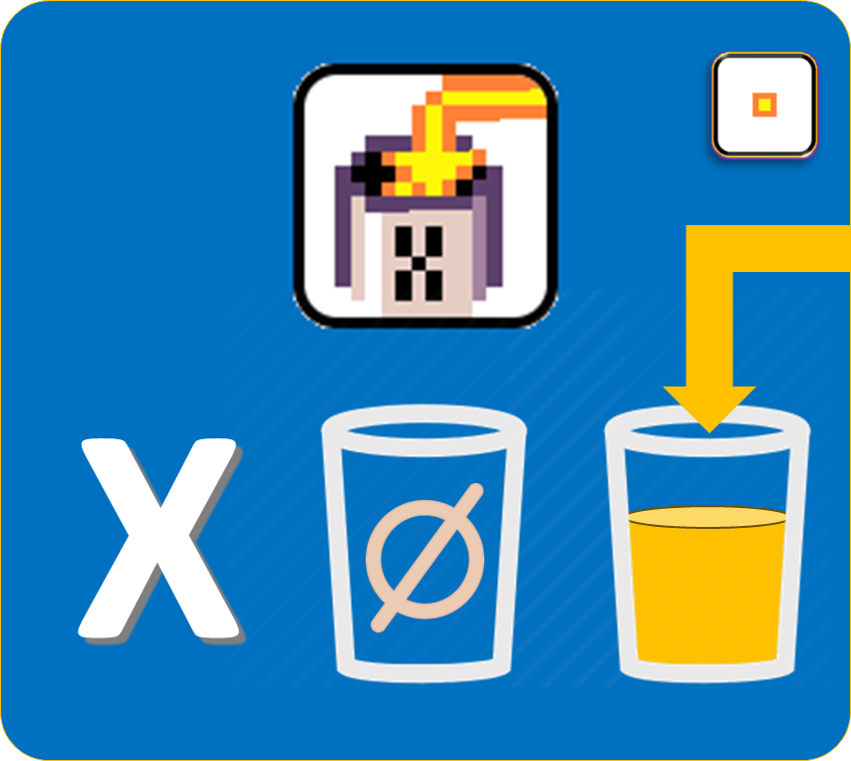
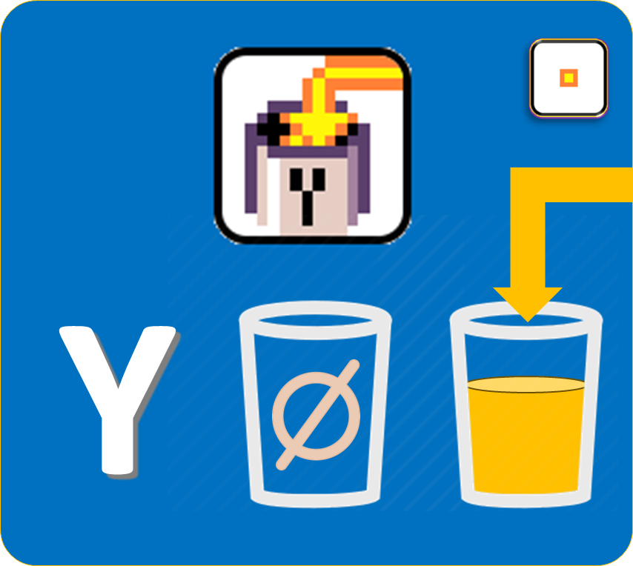
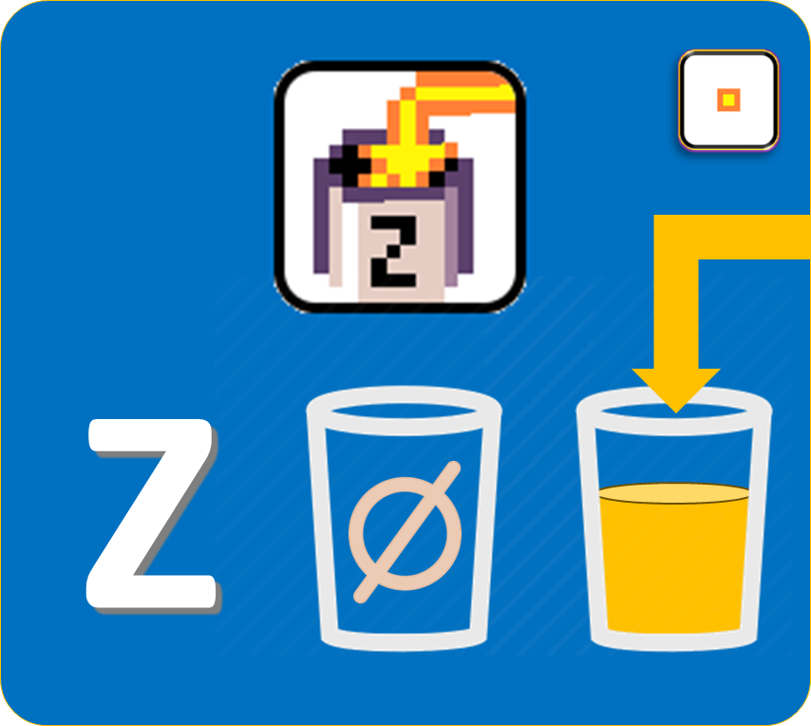
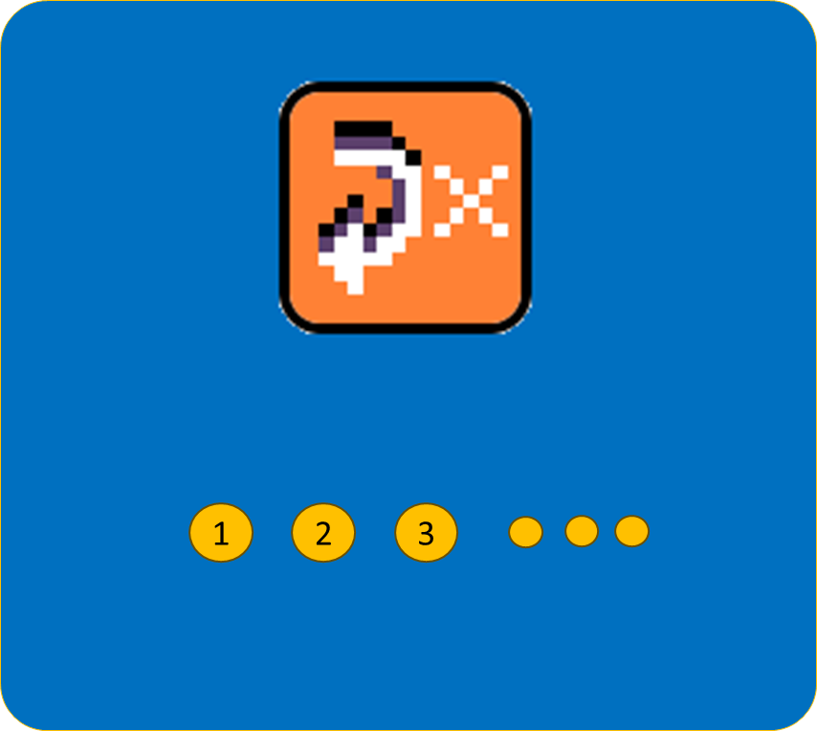

Slide 19



Slide 21
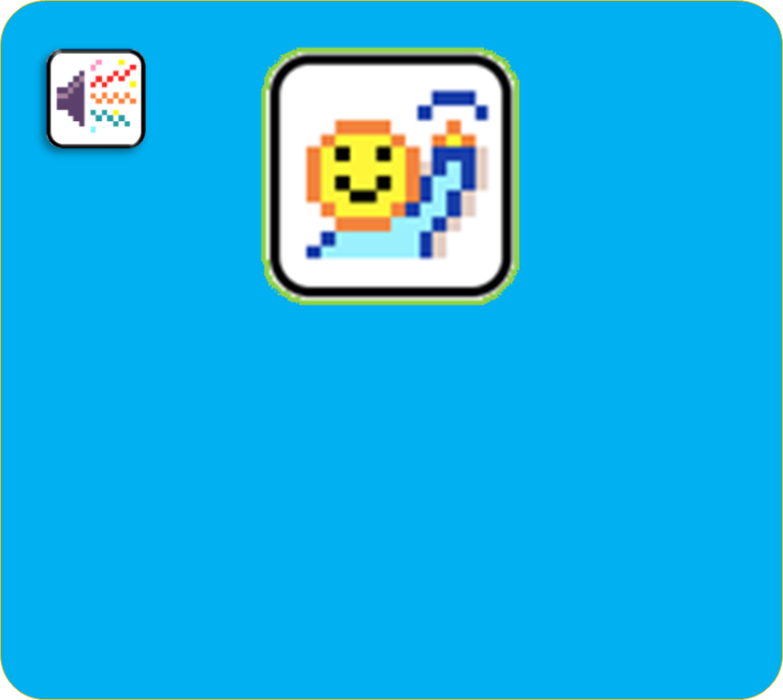
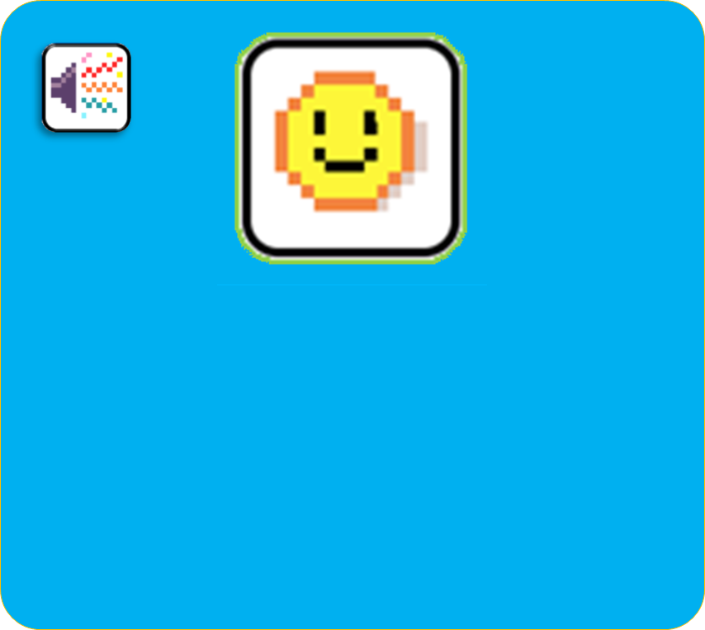
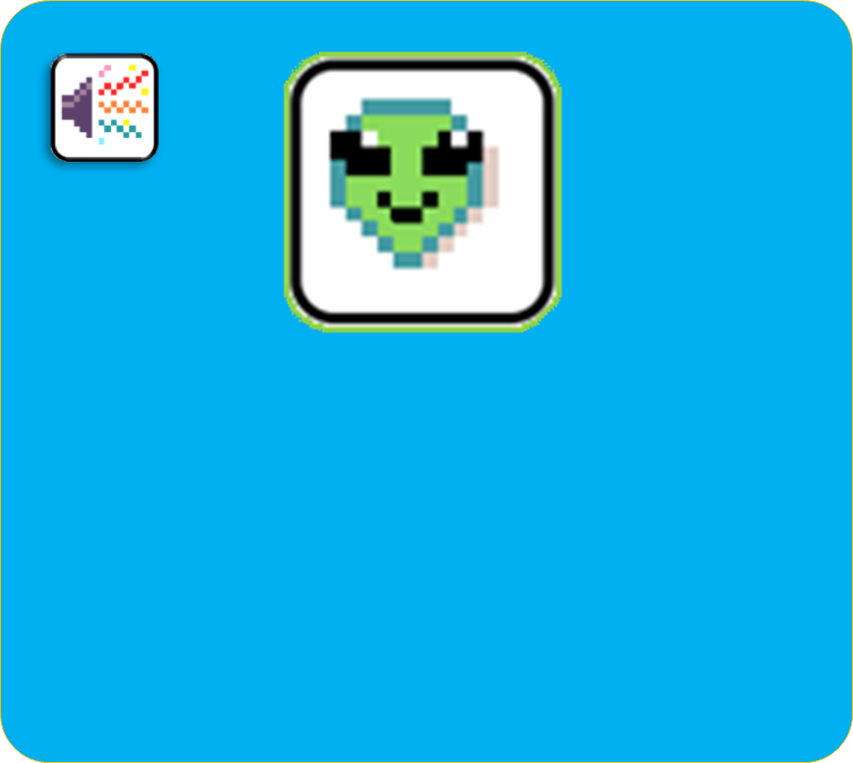
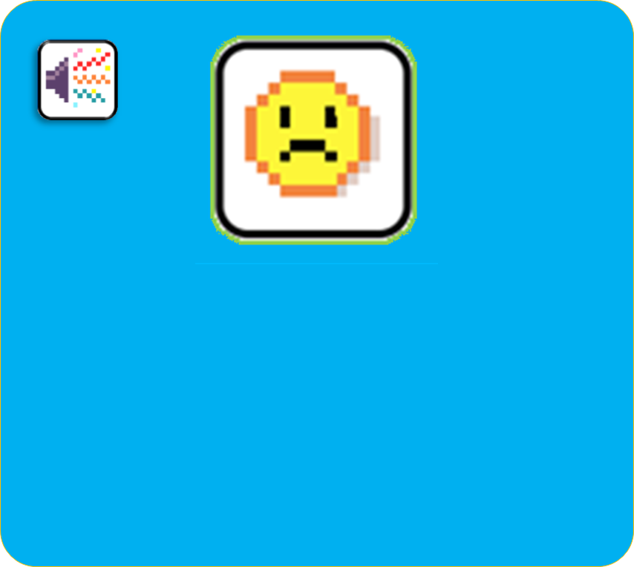
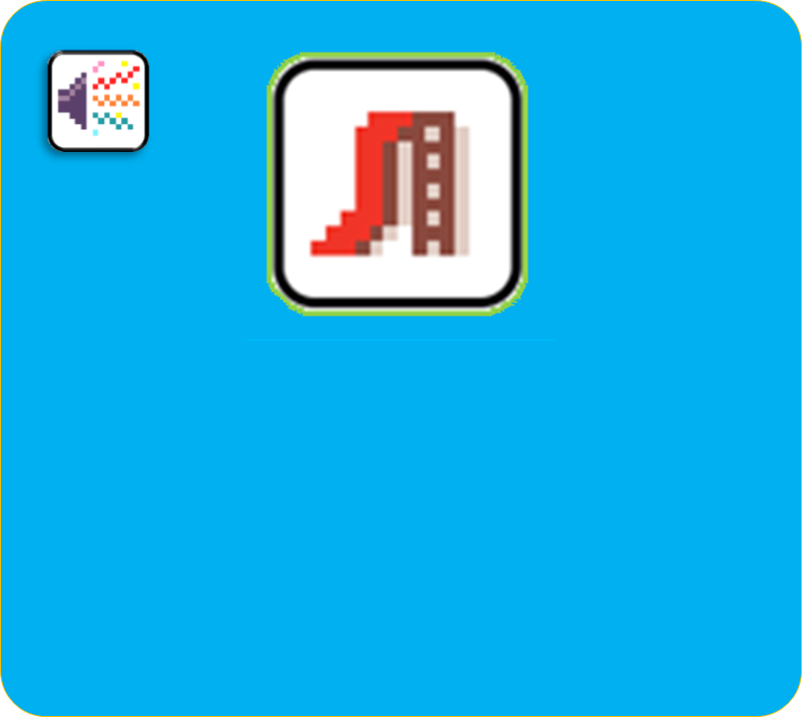

Slide 22


Slide 23
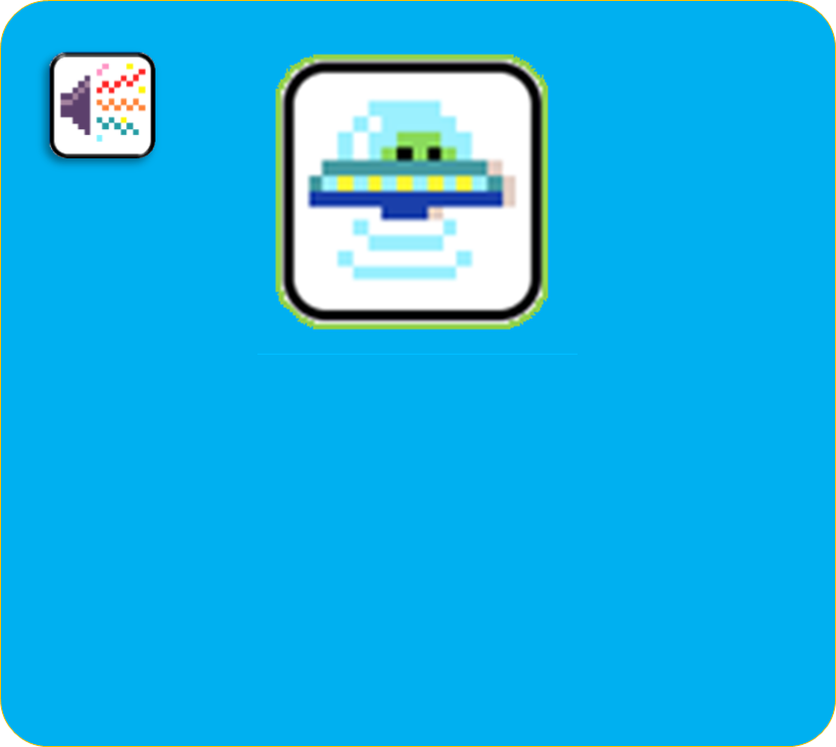
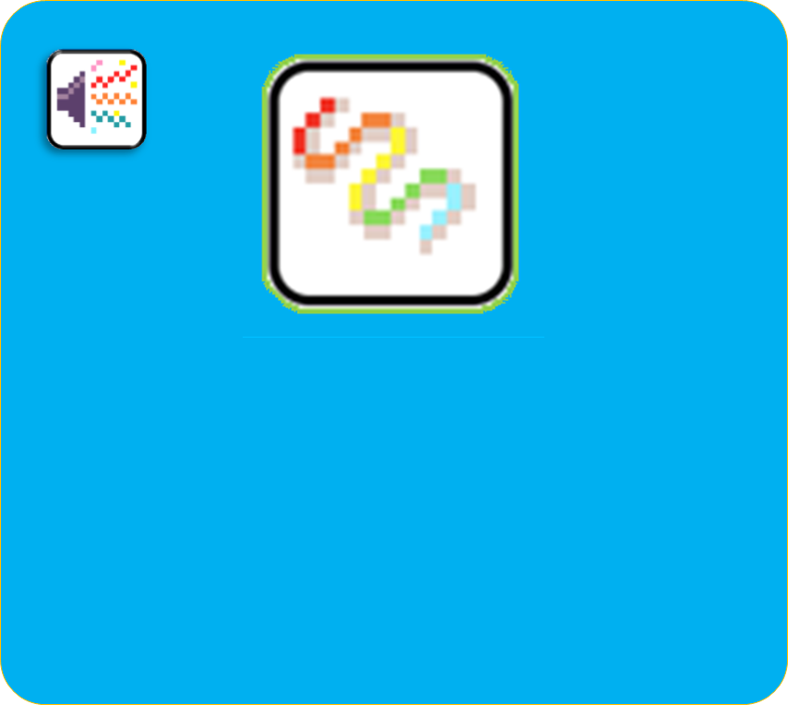
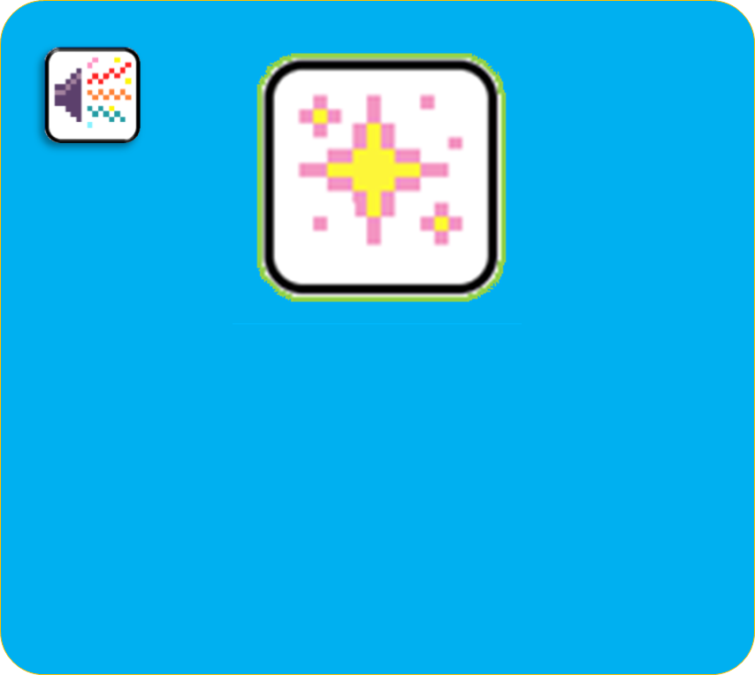
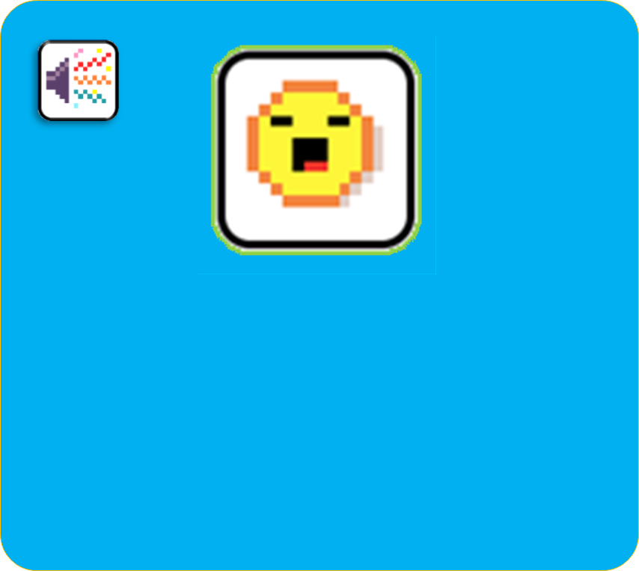
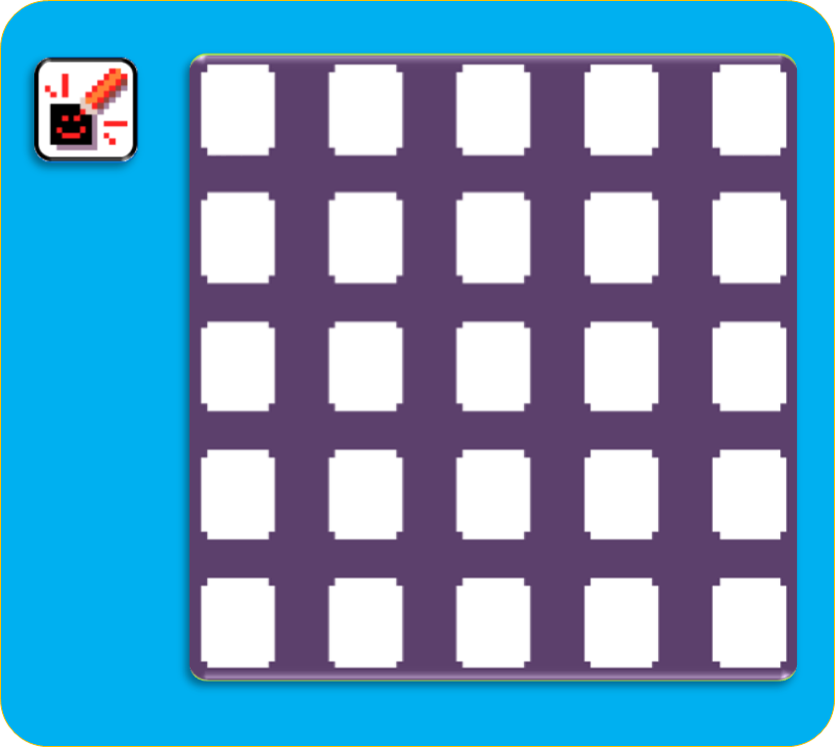


Slide 27






Slide 29







Slide 30


Slide 31






Slide 35




Slide 36


Slide 37



Slide 38


Slide 39


Slide 40


Slide 41


Slide 42


Slide 43


Notes:
Picture of hand
shaking micro:bit

Slide 44


Notes:
Picture of hand
shaking micro:bit

Slide 45



Notes:
Picture of hand
shaking micro:bit

Slide 46


Notes:
Picture of hand
shaking micro:bit

Slide 47


Notes:
Picture of hand
shaking micro:bit

Slide 48


Notes:
Picture of hand
shaking micro:bit

Slide 49


Slide 50



Slide 51



Slide 52




Slide 54
¼ sec.

Slide 55
1 sec.

Slide 56
5 sec.

Slide 57

0-1 sec.

Slide 58


Slide 59



Slide 60



Slide 61



Slide 62


X

Slide 63
Y

Slide 64
Z

Slide 65


Slide 66


Slide 68

G
F
E
D
C

Slide 70


Slide 80


Slide 81


Slide 89


X
Notes:
Picture for this???

Slide 90
Y

Slide 91
Z

Slide 92
1

Slide 93
2

Slide 94
3

Slide 95
4

Slide 96
5

Slide 97


X

Slide 98
Y

Slide 99
Z

Slide 100

1-?

Slide 102

Notes:
Radio value

Slide 103

1
2
3

Slide 104
Jacdac tiles

Slide 105


Slide 110


Slide 111
Misc

Slide 115


Slide 116


Slide 118


Slide 119


Slide 121


Slide 122



Events and Filters
Actions and Modifiers

Slide 123



Slide 124


Slide 125


Slide 126



Slide 127


Slide 128




Slide 129


